Slide 1
Air Quality Prediction and Analysis using ANN and ANFIS
Presented by: Tarun Kumar Ravipati
Sudheer Nimmagadda

Slide 2
Introduction
Motivation
Data Collection and preprocessing
Implementation
Artificial Neural Networks
ANFIS
Validation
Results
Conclusion
Future Work
CONTENTS

Slide 3
Introduction
Pollutants in the atmosphere is a major problem in metropolitan cities due to vehicle and factory pollution.
Preliminary measures of safety towards hazards need to be taken to prevent the levels of pollution from going up.
In order to undertake preventive measures, we need to predict the content of atmosphere that is being polluted.
In order to predict the future pollution levels we use the concepts of Artificial Neural Networks and Adaptive Neuro Fuzzy Inference Systems(ANFIS).

Slide 4
Motivation
Asthma and other lung oriented diseases are mainly caused by the pollutants of the atmosphere.
If we predict the levels of these contents during a certain interval of time during a day, people can take precautionary measures such that they won’t be effected.
We have considered the major pollutants like NO2 and O3 because they have major impact on the people suffering from Asthma.
We design the models to generate alerts if the pollutant concentrations reach the safety threshold.

Slide 5
Motivation Cont...
The safety threshold values according to the Centre of Pollution Control Board(CPCB) are -
NO2 - 200 µg/m3
O3 - 100 µg/m3
In order to prevent the effects of these pollutants, there is a need in the local and global communities for efficient air prediction models.
These models predict the pollutant concentrations based on background concentration of pollutants, meteorological and geographical conditions and other local characteristics.

Slide 6
Data Collection
The data set we used is downloaded from the website of the Centre for Pollution Control Board(CPCB), www.cpcb.gov.in
This data set consists of 13 parameters both of particulate concentrations(gases like NO2 and O3...etc) and meteorological phenomenon(wind speed, direction,..etc)
The data was collected for a span of every 8 hours from 2011-15
Training Data: 2011-13 dataset
Validation and Testing Data: 2014 and 2015 dataset

Slide 7
Data Collection Cont...
The Dataset consists of the following 13 parameters -
A. Particulate Concentrations:
Benzene(BEN) 2. Bar Pressure(BP) 3. Carbon Monoxide(CO)
4. m,p-Xylene(MPXY) 5. Nitrous Oxide(NO) 6. Nitrogen Dioxide(NO2)
7. Ozone(O3) 8. Sulphur Dioxide(SO2) 9. Toluene(TOL)
B. Meteorological Concentrations:
10. Relative Humidity(RH) 11. Temperature(TEMP)
12. Wind Direction(WD) 13. Wind Speed(WS)

Slide 8
Data Preprocessing
The data consisted of a modest amount of inconsistencies in the form of unavailable and extreme/unrealistic observations.
The unrealistic data is cleaned and merged by using the nearest neighbour method i.e, the endpoints of the gaps were used as estimates for all the missing values between them.
The absolute values of the negative observations are considered.
Next, the standardization is done where features were shifted by the mean and scaled by their variance to obtain a standard normal distribution. This method of standardization is called Normalization.

Slide 9
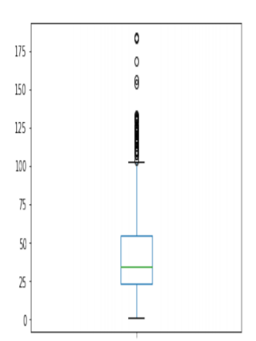
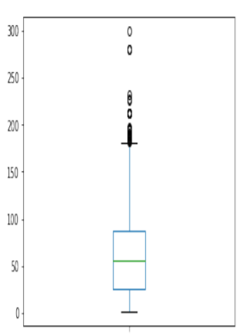
Data Preprocessing cont...
The box plots for a few parameters in final training data are as follows:
NO2
O3

Slide 10
Implementation
Artificial Neural Networks
The prediction of pollutants in the next 8 hrs was modeled as a regression problem using an artificial neural network.
The regression problem is used to establish a relation between one variable and corresponding values of other variables. This is required for the prediction of a quantity.
The optimization algorithm used is gradient descent which is achieved using back propagation in the feed-forward neural network.
The back propagation is done in the ANN’s having different number of hidden layers. The optimized values that are obtained in a specific set of hidden layers, is selected.
In a neural network, hidden layers act as feature detectors

Slide 11
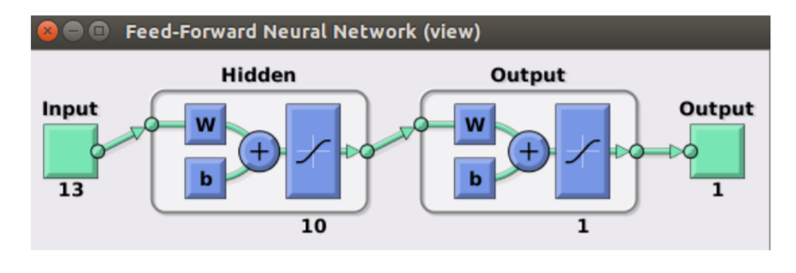
Artificial Neural Networks cont...
According to the universal approximation theory, a network with a single hidden layer with a sufficiently large number of neurons can approximate any smooth, measurable function between input and output vectors by selecting a suitable set of connecting weights and transfer functions.

Slide 12
Artificial Neural Networks cont...
PCA-ANN:
PCA was considered as a tool capable of providing an overview of the inter-dependencies and variability of data and extracting information for forecasting mechanisms.
The role of PCA is to reduce the number of predictor variables and transform them into new variables which are called principal components (PC).
The correlation matrix of standardized data can compute the PCs.
This correlation matrix relates concentration of NO2 and O3 with other predictor variables.
The PCs whose cumulative amount of variance are approximately 90% are used in the model and remaining components were excluded.

Slide 13
Implementation
B. Adaptive Neuro-Fuzzy Inference System(ANFIS)
The ANFIS method uses a hybrid architecture composed of a fuzzy inference system (FIS) enhanced with ANN features.
Integrating the ANN part into a fuzzy inference system enhances the FIS part with learning/adapting capabilities.
The training data determine restrictions on the design methods for the rule base and membership functions.
Subtractive clustering has been used to generate initial FIS structure, i.e. rules, whose antecedent and consequent parameters are then tuned using neural network.

Slide 14
Adaptive Neuro-Fuzzy Inference System(ANFIS) cont...
The FIS(Fuzzy Inference System) has five functional units:
Fuzzification Unit (Crisp value to Fuzzy set)
The database unit (containing the description of membership functions for input/output variables)
A rule base Unit (All the rules defined for FIS)
A defuzzification unit (from fuzzy set to a crisp value)
The decision unit (performing the inference operations on the fuzzy rules)

Slide 15
Adaptive Neuro-Fuzzy Inference System(ANFIS) cont...
The ANFIS architecture has five layers, with Takagi-Sugeno rules.
The first layer (adaptive) forms the premise parameters (the IF part with inputs and their membership functions).
The second layer computes a product of the involved membership functions.
The third layer normalizes the sum of inputs.
In the fourth layer, the adaptive i-node computes the contribution of i-th rule to ANFIS output, forming the consequent parameters (the THEN part with output and its membership function).
The fifth layer makes the summation of all inputs.

Slide 16
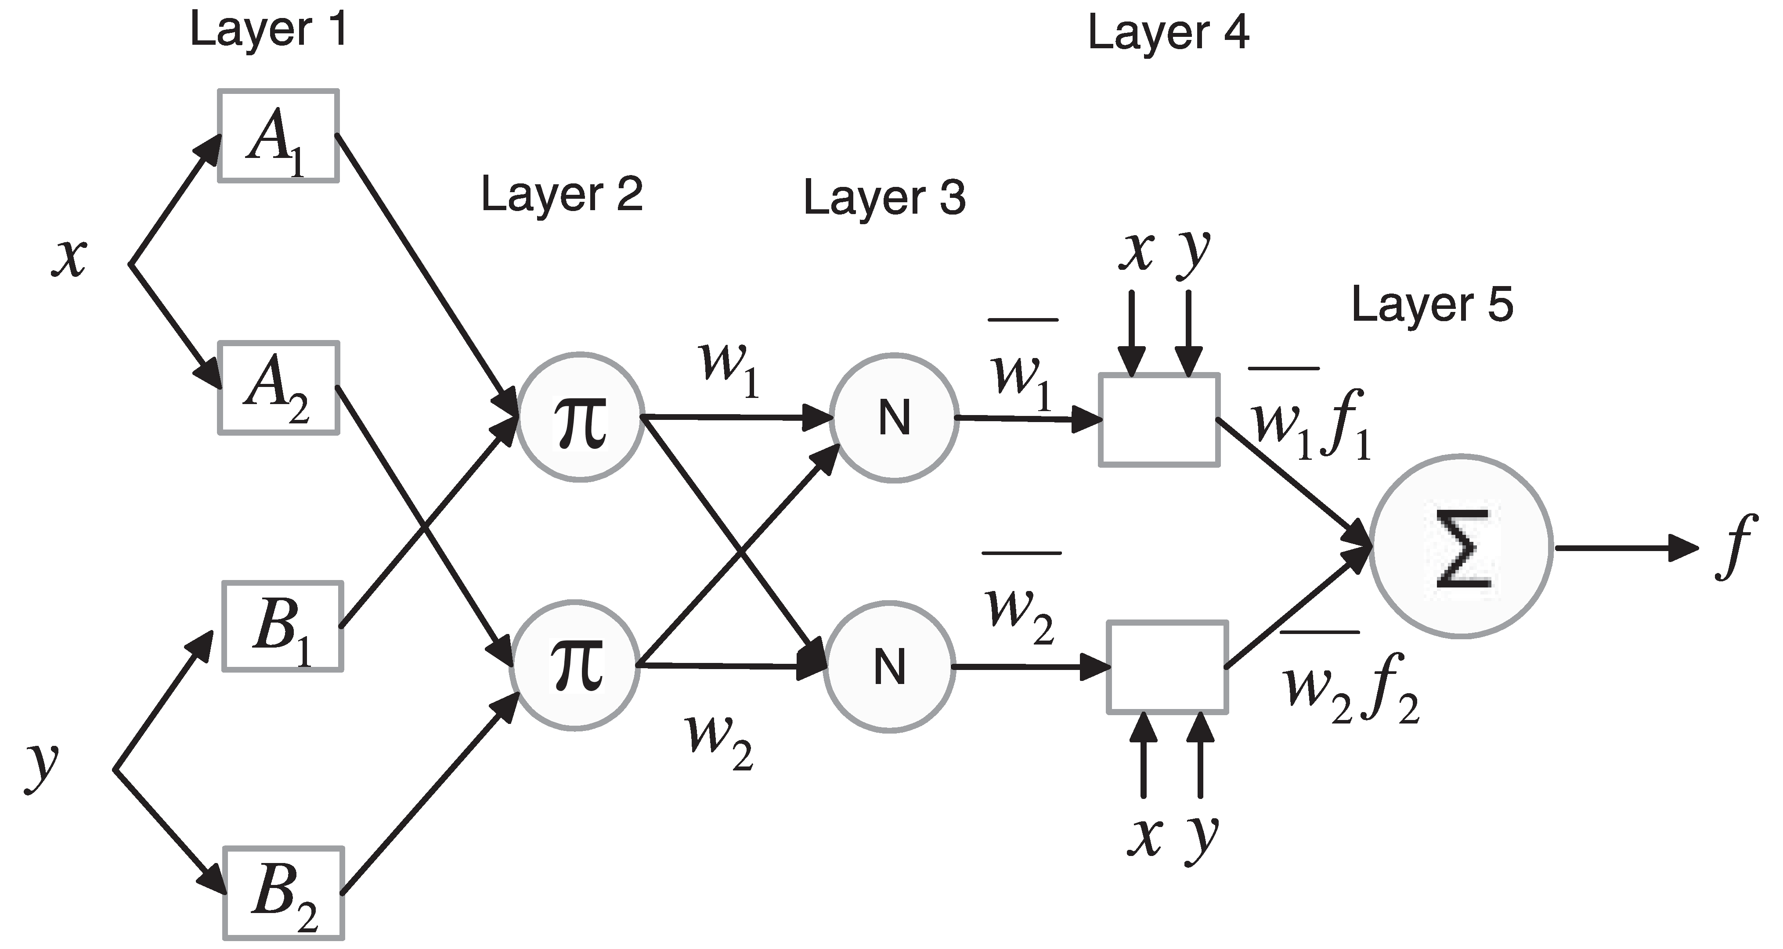
Implementation
B. Adaptive Neuro-Fuzzy Inference System(ANFIS)
Structure:

Slide 17
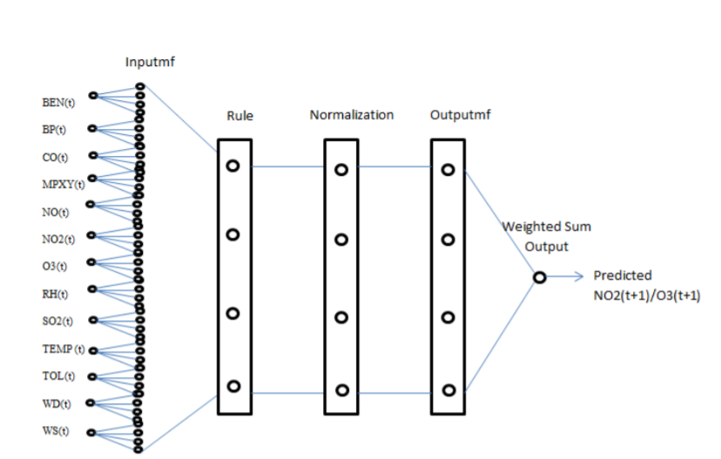
ANFIS ARCHITECTURE

Slide 18

Adaptive Neuro-Fuzzy Inference System(ANFIS) cont...
ANFIS applies a hybrid learning algorithm (H) or backpropagation (BP) algorithm.
The hybrid learning algorithm(H) identifies premise parameters with gradient method ( )
The consequent parameters with least square method. At feedforward propagation step from H, the system output reaches layer 4, and the consequent parameters are formed with least square method.
2. With backpropagation (BP) optimization method, the error signal is fed back and the new premise parameters are computed through gradient method.

Slide 19
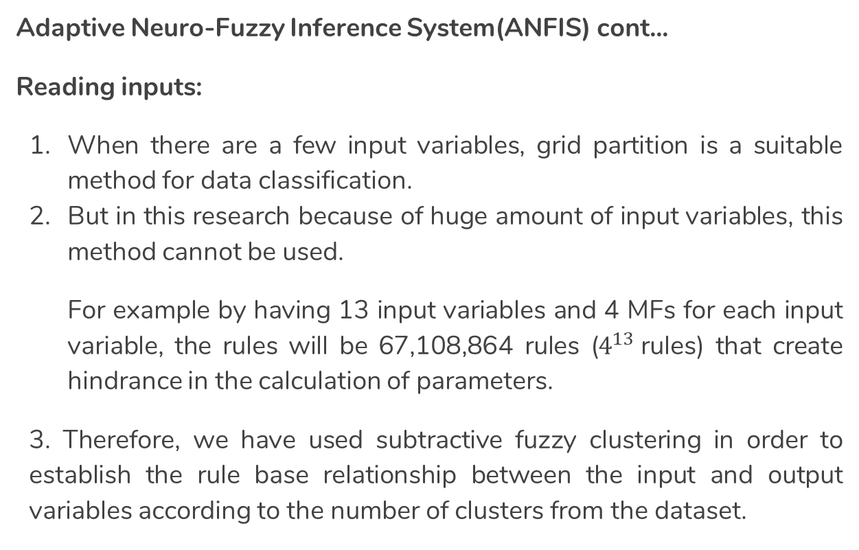
Adaptive Neuro-Fuzzy Inference System(ANFIS) cont...
Reading inputs:
When there are a few input variables, grid partition is a suitable method for data classification.
But in this research because of huge amount of input variables, this method cannot be used.
For example by having 13 input variables and 4 MFs for each input variable, the rules will be 67,108,864 rules ($4^{13}$rules) that create hindrance in the calculation of parameters.
3. Therefore, we have used subtractive fuzzy clustering in order to establish the rule base relationship between the input and output variables according to the number of clusters from the dataset.

Slide 20
Adaptive Neuro-Fuzzy Inference System(ANFIS) cont…
Input conditions:
Subtractive Clustering is based on a measure of the density of data points in the feature space that finds clusters based on the given search radius.
The optimal values for radius are identified through a trial and error procedure by varying the radius from 0.1 to 0.9.
The membership functions were Gaussian and the optimization algorithms of the ANN were backpropagation and hybrid.
In training step, 150 epochs of hybrid algorithm for correction of model parameters are considered.

Slide 21
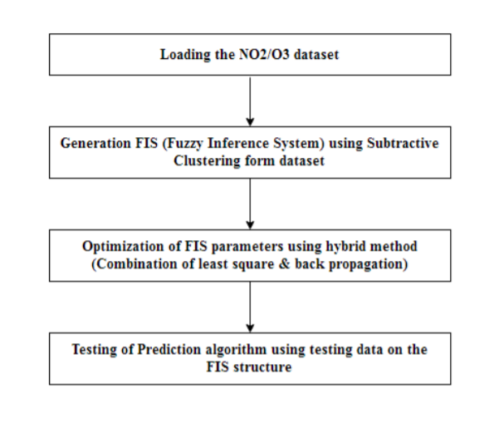
The flow of ANFIS

Slide 22
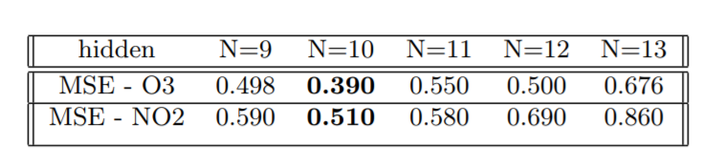
Validation
We implemented ten different ANN models (5 for NO2 and 5 for O3 predictions) with different number of hidden neurons and trained using the same set of training data. The Mean Square Error(MSE) for different sets of hidden layers is calculated and compared.
The neural network with 10 hidden layers gives the best prediction because the MSE is minimum for it. At a particular epoch, this error is found to be the least.

Slide 23
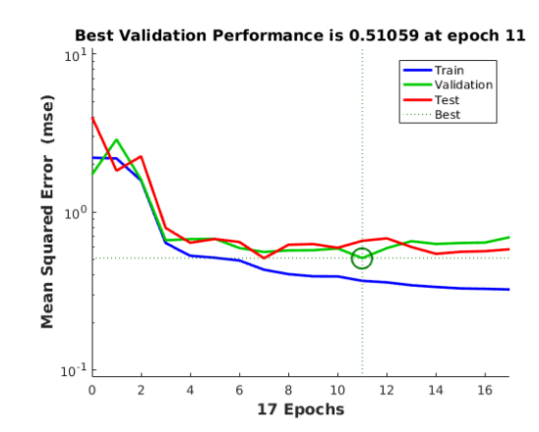
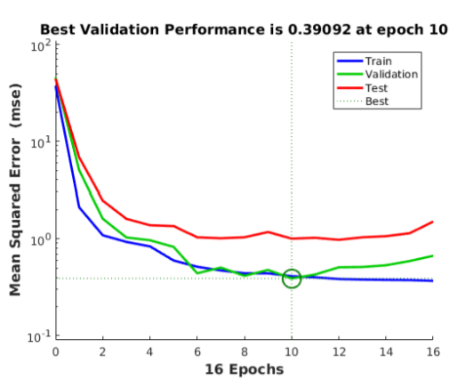
The validation results obtained for NO2 and O3 are only considered because, these two are the key components that contribute to air pollution. The Best validation performance is found out by plotting the graph between Mean Square Error and No.of Epochs.
NO2
O3

Slide 24
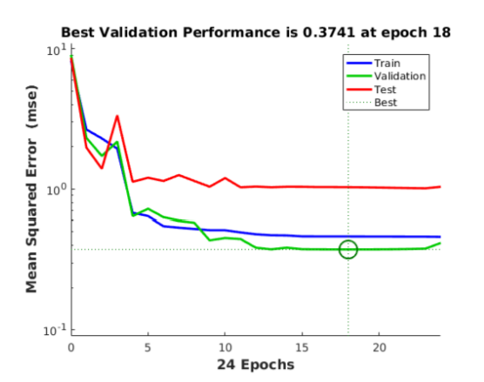

The remaining 11 parameters are included in the regression plots to match the targets and outputs. The principal Component Analysis is done for the target and output to indicate a relation is used for dimensionality reduction. The PCA-ANN exhibits better performance for O3 component for n=13(hidden layers).
The NO2 component has a performance of
0.63903 at epoch 14, which is less
Efficient compared to normal ANN.

Slide 25
Inference:
Hence we obtained the best performances as follows -
For NO2, at Epoch 11 having 10 hidden neurons in a general Artificial Neural Network.
For O3, at Epoch 18 having 13 hidden neurons in a Principal Component Analysis- Artificial Neural Networks(PCA-ANN).
Now, we draw regression plots between the targets and outputs to check the type of relationship.

Slide 26
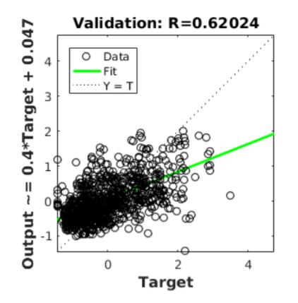
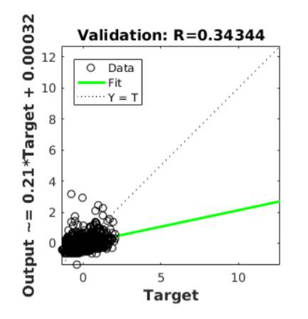
If R=1, there is an exact linear relationship between outputs and targets. If R is close to 0, then there is no relation between outputs and targets.
NO2
O3

Slide 27
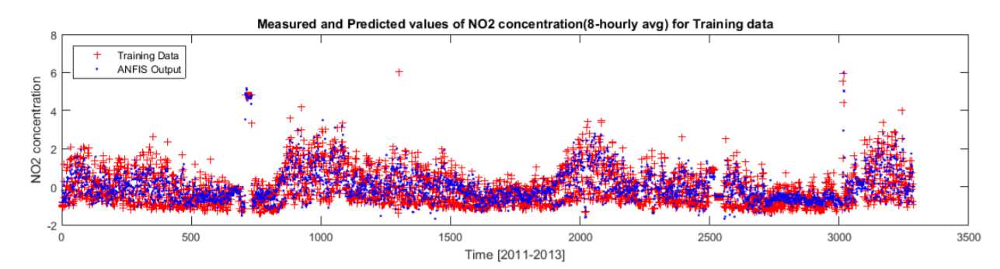
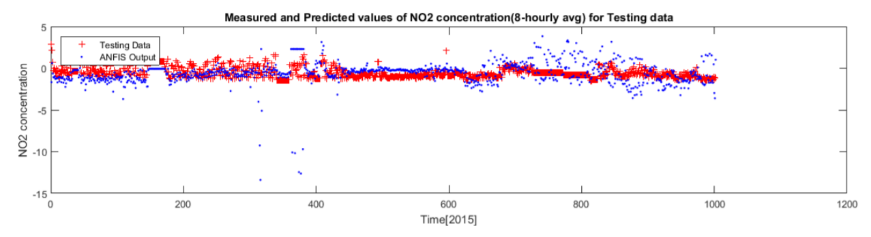
ANFIS validation:The scatter plots for training and testing data for NO2 are -

Slide 28
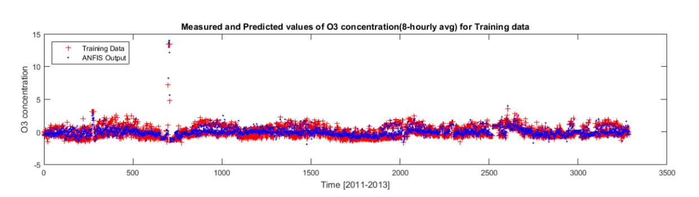
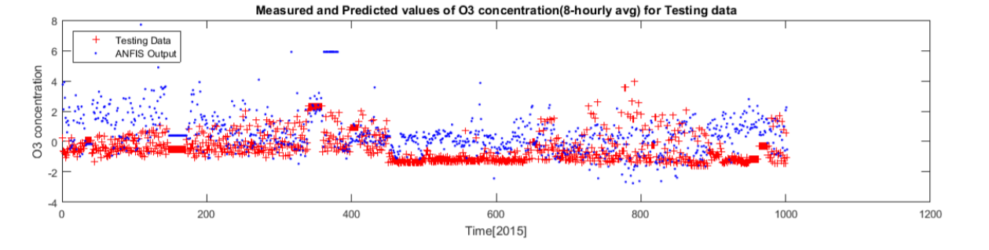
ANFIS validation:The scatter plots for training and testing data for O3 are -

Slide 29
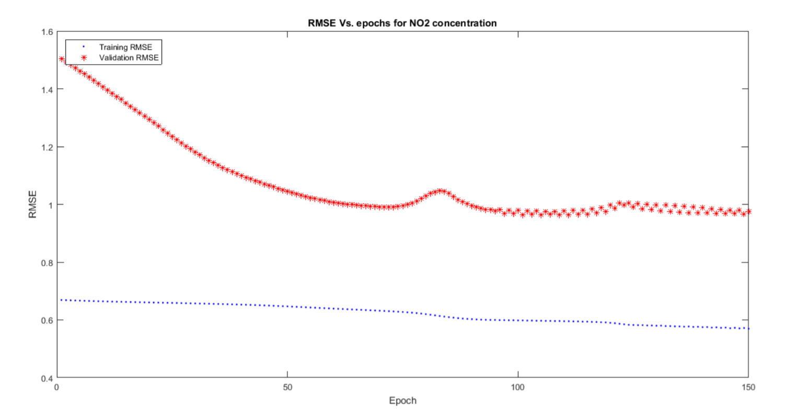
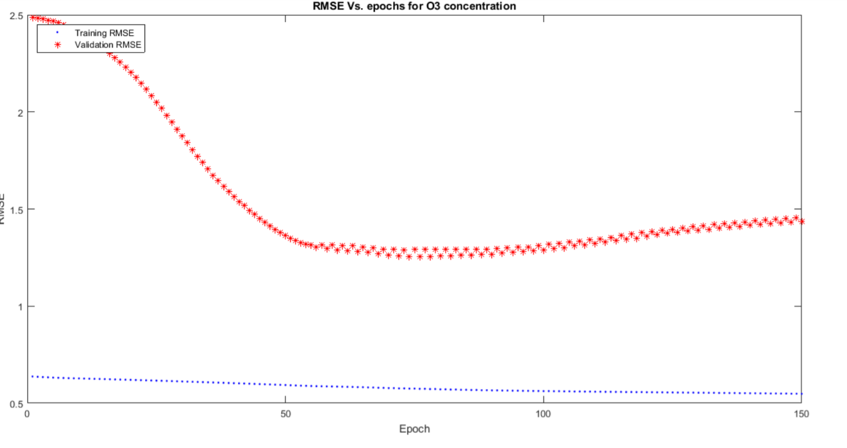
RMSE Vs Epochs
The Root Mean Square Error is different at different epochs.
So, we plot it to find the epoch with least RMSE.

Slide 30
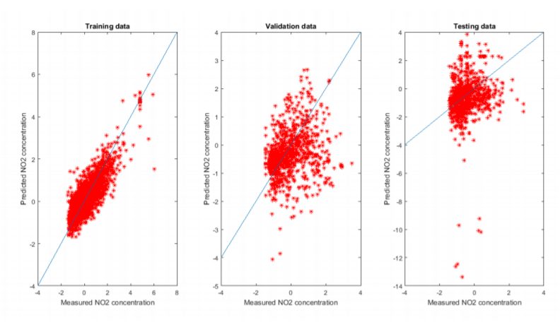
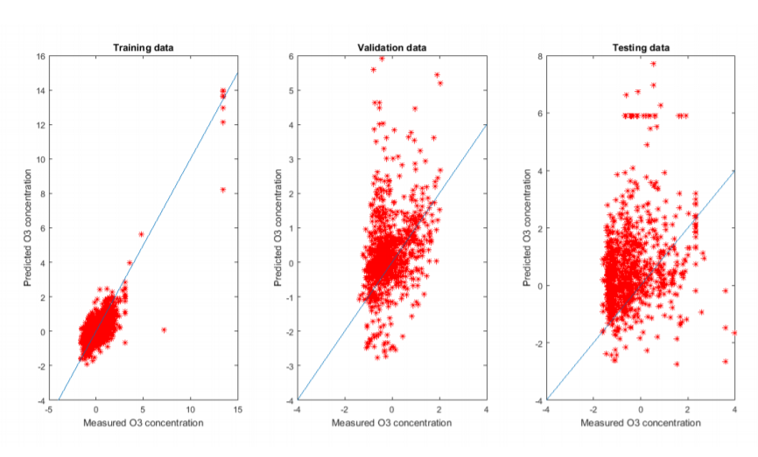
Regression plots for NO2 and O3 for ANFIS
NO2
O3

Slide 31
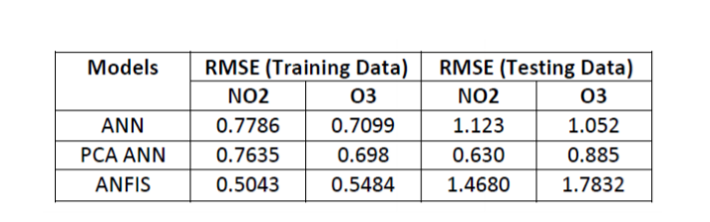
Results and Conclusion
The results we obtained from various methods are tabulated below -
Hence the following can be inferred from the above:
The ANFIS has the lowest RMSE for both NO2 and O3 for the training data.
The PCA-ANN has the lowest RMSE for both NO2 and O3 for the testing data.

Slide 32
Future Work
We deploy more values in the training and testing data set to infer near optimum values of each model and thereby achieving efficiency.
We develop an application that generates alerts automatically if the air pollution levels are high for every eight hours.
The reliability of this models will be checked for more inconsistent data in the future.

Slide 33


